Slide 1
Drift Model
Mark Lindeman

Slide 2
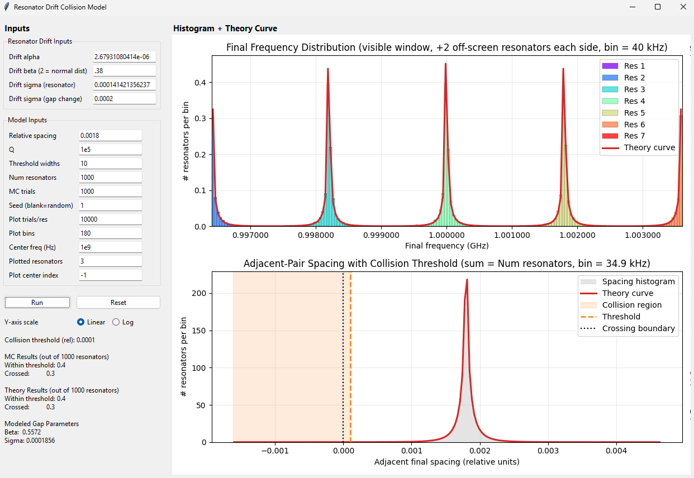
Overview
In this document, we estimate how much drift is acceptable to avoid collisions between resonators
We use empirical measurements of the changes in frequency gaps between resonators find values for model parameters
We assume that a collision occurs when resonator frequencies are within 10/Q from each other
Use Q=100000
Collision if df/f <1e-4
We find that gap changes do not have normal distribution but instead have heavier tails. Therefore, we use a generalized normal distribution.
We estimate the acceptable size of the standard deviation (STD) of the gap change to avoid pile ups based on the observed distribution
We find that the STD of the gaps changes should be less than about 3.1e-4 to have less than 1 collision in a 1000 resonators

Slide 3
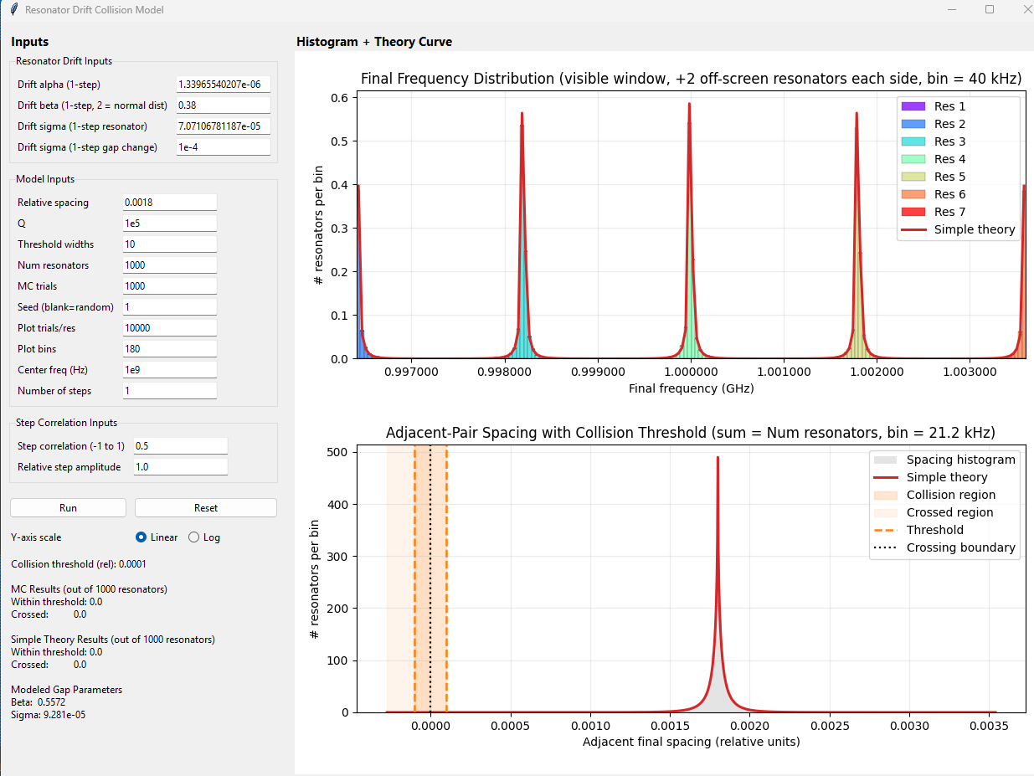
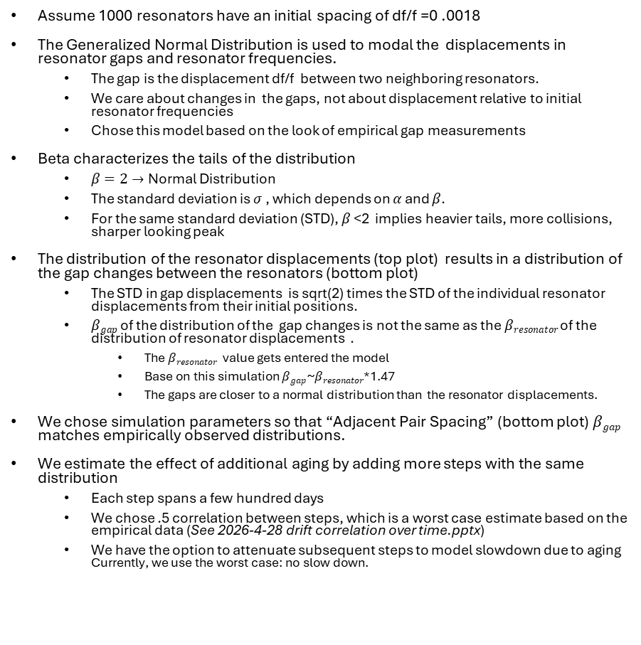
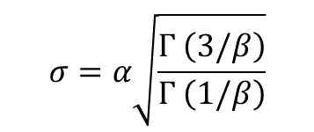
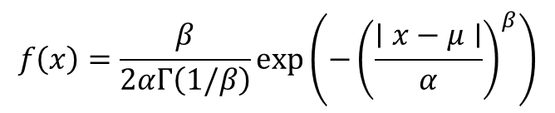
Generalized Normal Distribution Model
Generalized Normal Distribution
$$f\left(x\right)=\frac{β}{2αΓ\left(1/β\right)}\exp\left(−{\left(\frac{∣x−μ∣}{α}\right)}^{β}\right)$$
$$σ=α\sqrt{\frac{Γ \left(3/β\right)}{Γ \left(1/β\right)}}$$
Assume 1000 resonators have an initial spacing of df/f =0 .0018
The Generalized Normal Distribution is used to modal the displacements in resonator gaps and resonator frequencies.
The gap is the displacement df/f between two neighboring resonators.
We care about changes in the gaps, not about displacement relative to initial resonator frequencies
Chose this model based on the look of empirical gap measurements
Beta characterizes the tails of the distribution
$β=2→$Normal Distribution
The standard deviation is $σ$ , which depends on $α$ and $β$.
For the same standard deviation (STD), $β$ <2 implies heavier tails, more collisions, sharper looking peak
The distribution of the resonator displacements (top plot) results in a distribution of the gap changes between the resonators (bottom plot)
The STD in gap displacements is sqrt(2) times the STD of the individual resonator displacements from their initial positions.
$βgap$ of the distribution of the gap changes is not the same as the $βresonator$of the distribution of resonator displacements .
The $βresonator$ value gets entered the model
Base on this simulation $βgap$~$βresonator$*1.47
The gaps are closer to a normal distribution than the resonator displacements.
We chose simulation parameters so that “Adjacent Pair Spacing” (bottom plot) $βgap$ matches empirically observed distributions.
We estimate the effect of additional aging by adding more steps with the same distribution
Each step spans a few hundred days
We chose .5 correlation between steps, which is a worst case estimate based on the empirical data (See 2026-4-28 drift correlation over time.pptx)
We have the option to attenuate subsequent steps to model slowdown due to aging Currently, we use the worst case: no slow down.
Resonator Drifts and Gaps

Slide 4
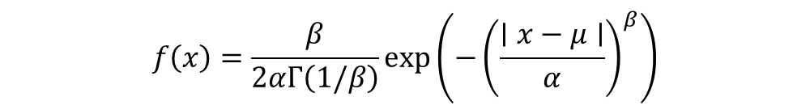
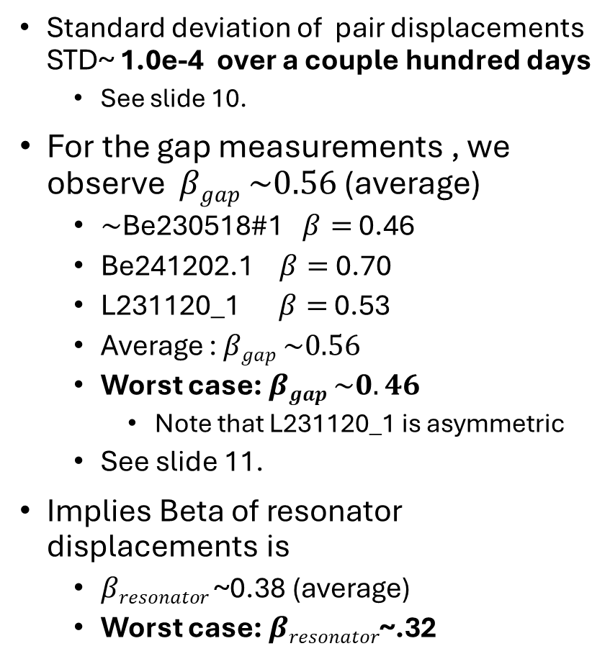
Empirical Parameters for the Model
Generalized Normal Distribution
$$f\left(x\right)=\frac{β}{2αΓ\left(1/β\right)}\exp\left(−{\left(\frac{∣x−μ∣}{α}\right)}^{β}\right)$$
Standard deviation of pair displacements STD~ 1.0e-4 over a couple hundred days
See slide 10.
For the gap measurements , we observe $βgap \sim 0.56$ (average)
$\sim$Be230518#1 $β=$ 0.46
Be241202.1 $β=$ 0.70
L231120_1 $β=$ 0.53
Average : $βgap \sim 0.56$
Worst case: $βgap \sim 0.46$
Note that L231120_1 is asymmetric
See slide 11.
Implies Beta of resonator displacements is
$βresonator$~0.38 (average)
Worst case: $βresonator$~.32
Resonator Drifts and Gaps

Slide 5
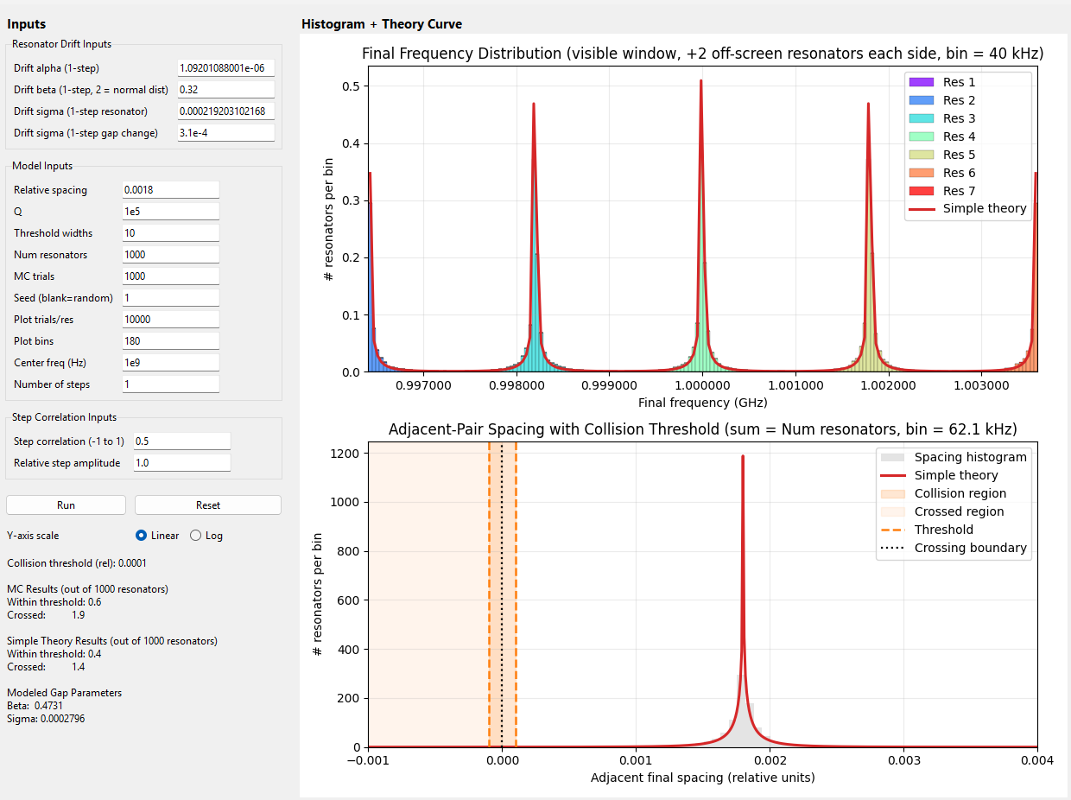
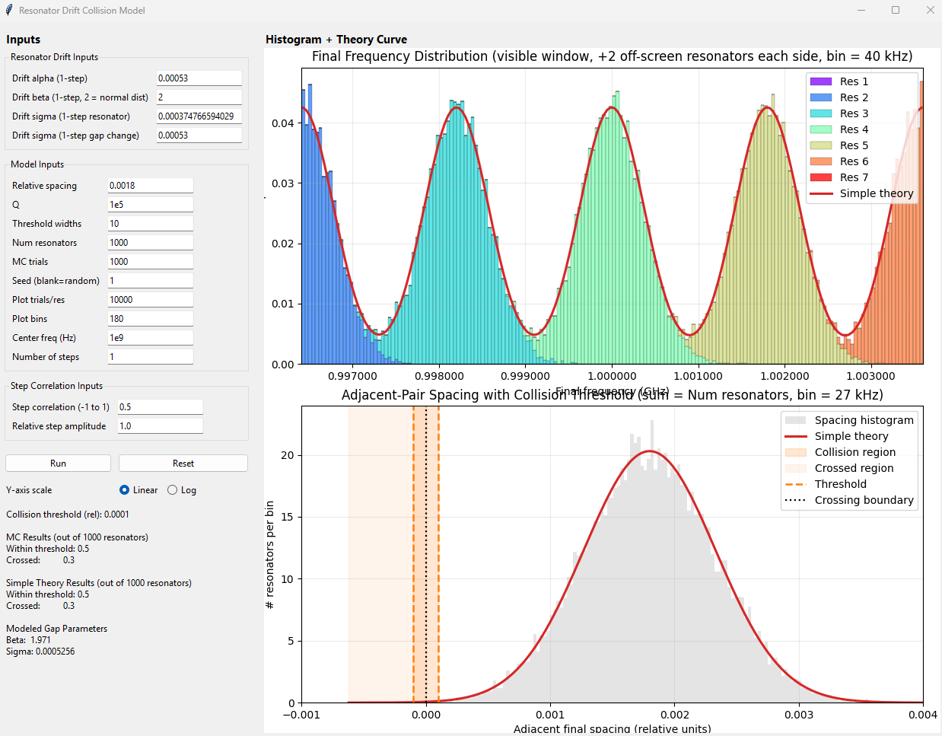
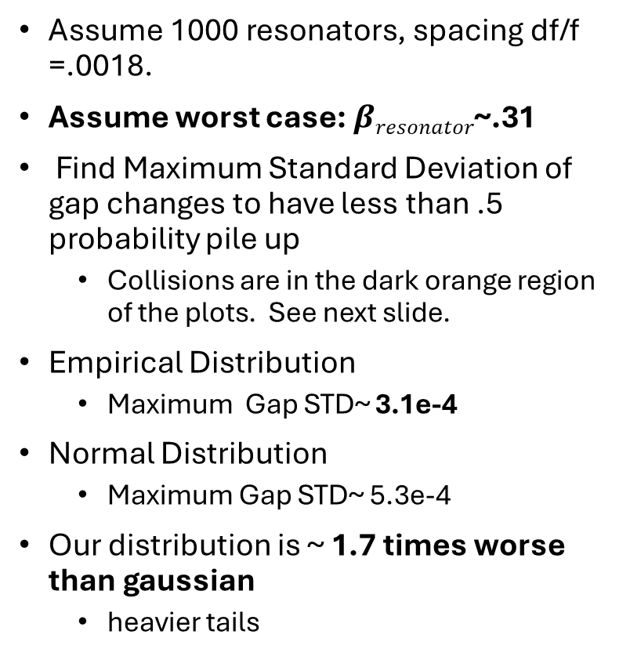
Realistic Distribution Compared to Gaussian –Linear Plots
Simulation of Realistic Distribution Max STD = 3.1e-4
Assume 1000 resonators, spacing df/f =.0018.
Assume worst case: $βresonator$~.31
Find Maximum Standard Deviation of gap changes to have less than .5 probability pile up
Collisions are in the dark orange region of the plots. See next slide.
Empirical Distribution
Maximum Gap STD~ 3.1e-4
Normal Distribution
Maximum Gap STD~ 5.3e-4
Our distribution is ~ 1.7 times worse than gaussian
heavier tails
Collisions
Simulation of the Normal Distribution Max STD= 5.3e-4

Slide 6
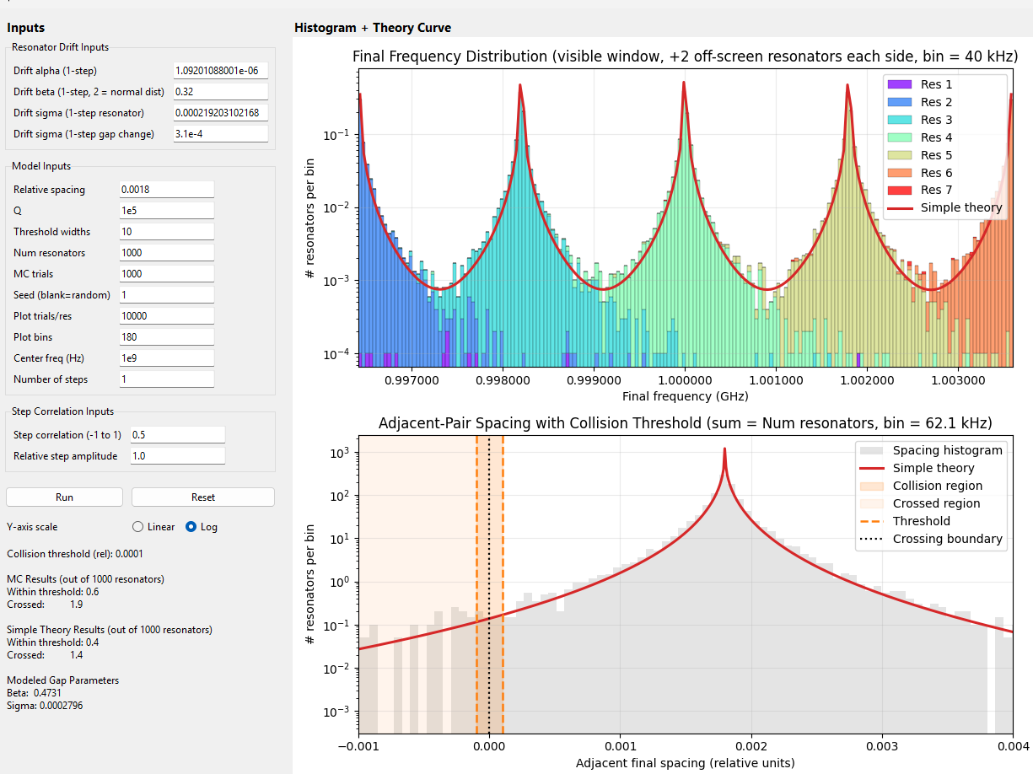
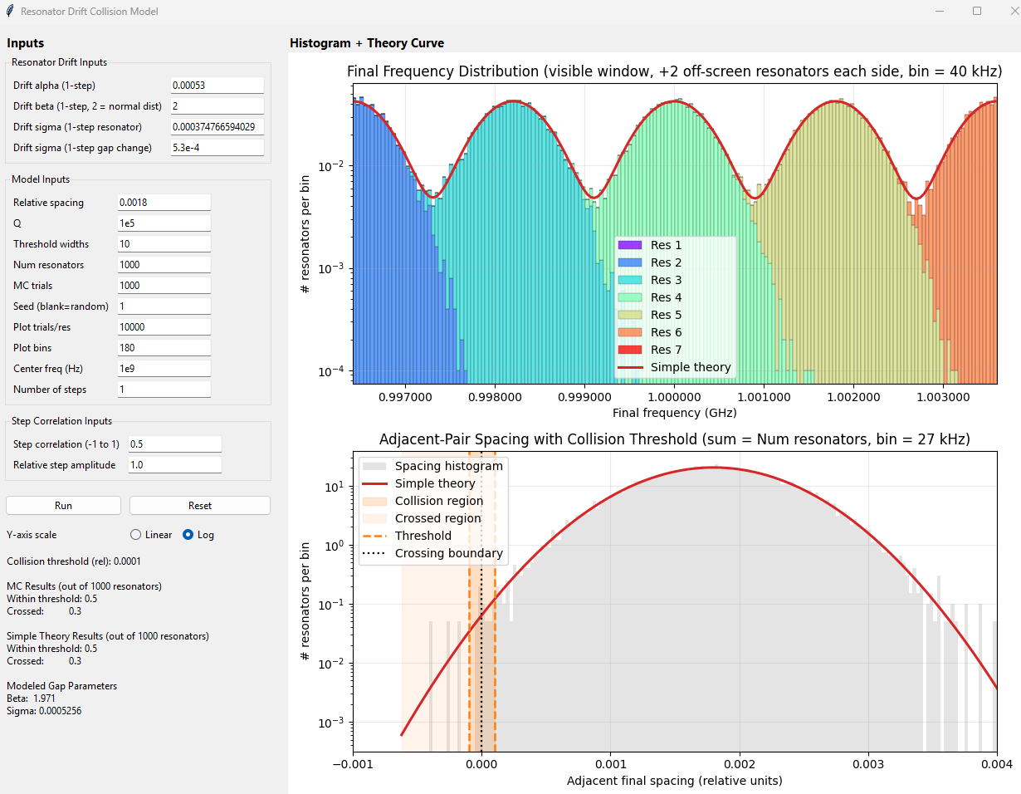
Empirical Distribution and Compared to Gaussian --Log plots
In log scale we can see that the two distributions have about the same number of collisions
Collision are in the dark orange region of bottom plot
Both have a probability of .5 of one resonator collision (for 1000 resonators total)
Realistic distribution : Max STD~ 3.1e-4
Normal distribution : Max STD~ 5.3 e-4
Therefore, the realistic model is ~ 1.7 times worse than gaussian
Simulation of Realistic Distribution Max STD~ 3.1e-4
Collisions
Simulation of the Normal Distribution Max STD~ 5.3 e-4

Slide 7
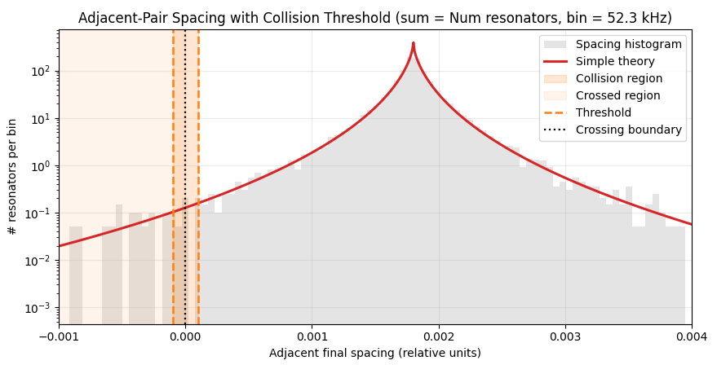
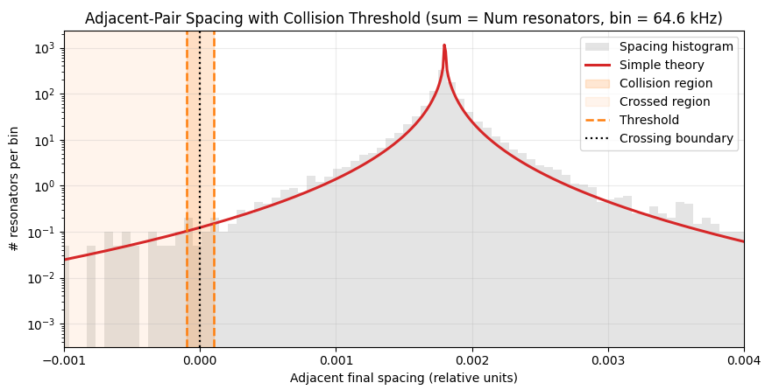
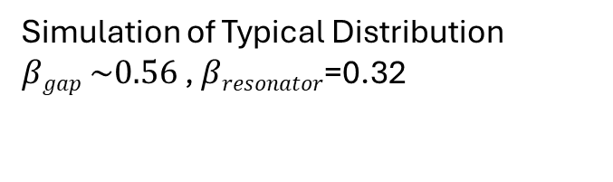
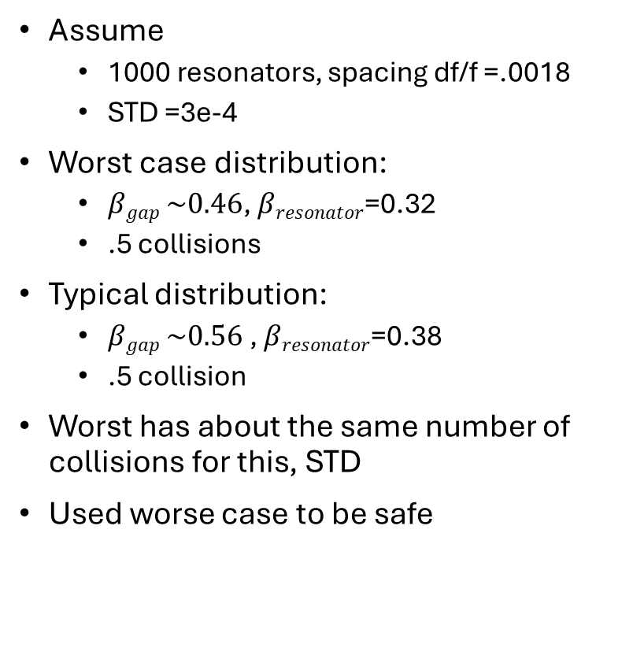
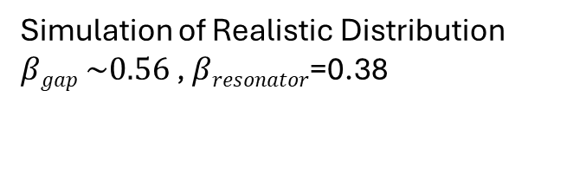
Empirical Distribution and --Worst case
Simulation of Realistic Distribution $βgap \sim 0.56$ , $βresonator$=0.38
Assume
1000 resonators, spacing df/f =.0018
STD =3e-4
Worst case distribution:
$βgap \sim 0.46$, $βresonator$=0.32
.5 collisions
Typical distribution:
$βgap \sim 0.56$ , $βresonator$=0.38
.5 collision
Worst has about the same number of collisions for this, STD
Used worse case to be safe
Simulation of Typical Distribution $βgap \sim 0.56$ , $βresonator$=0.32

Slide 8
Device Performance Compared to requirement
Collision requirement
Rhe STD of neighbors net displacement < 3.1e-4
This implies a probability of less than 1 collision in 1000 resonators, given the observed statistics
4 of 5 Sensor sensors measure 1e-4 over a duration of hundreds of days
But we need to stay within the requirement over 2 years
This may is possible because shifts are not perfectly correlated over time
Sensor | STD Net Change (df/f) | Number of Days | Ratio to Lowest rate | Ratio to Lowest Net Change | Ratio to Req: STD Net change < 3.1e-4
Be230518#1 | 1.0E-03 | 374 | 26.3 | 10.0 | 3.2
Be241202.1 | 9.0E-05 | 100 | 5.3 | 0.9 | 0.3
L121120_1 | 1.1E-04 | 384 | 1.3 | 1.1 | 0.4
MIT R3C4 Not Florinated | 1.0E-04 | 287 | 1.0 | 1.0 | 0.3
MIT R4C4 -Florintated | 1.0E-04 | 48 | 6.1 | 1.0 | 0.3
+/- 2e-4 or less

Slide 9
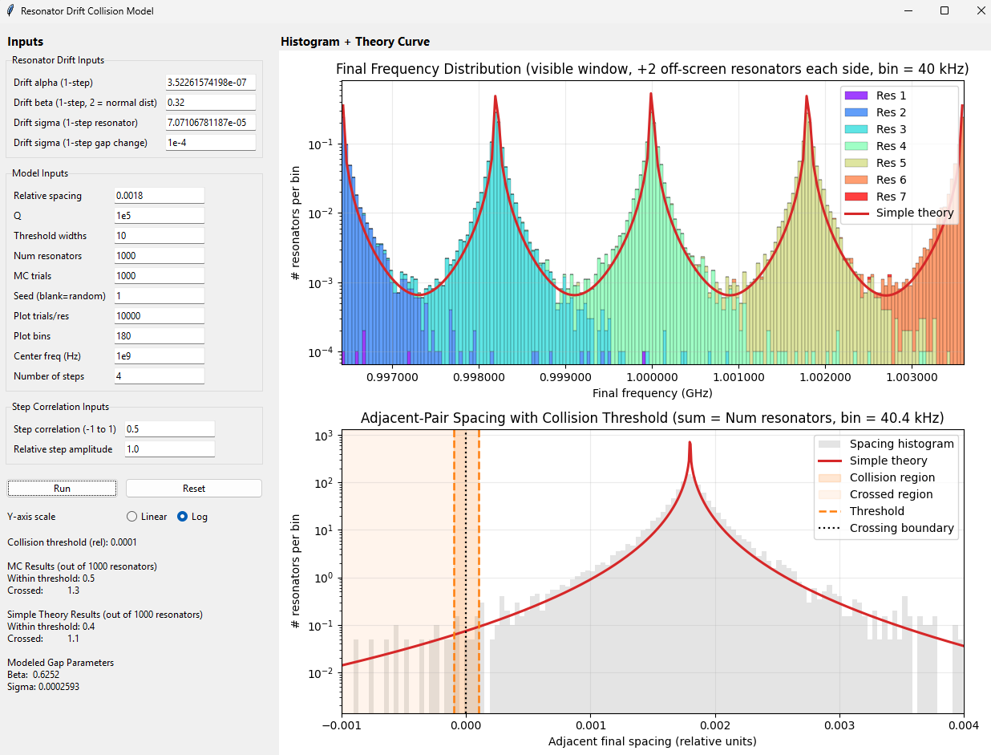
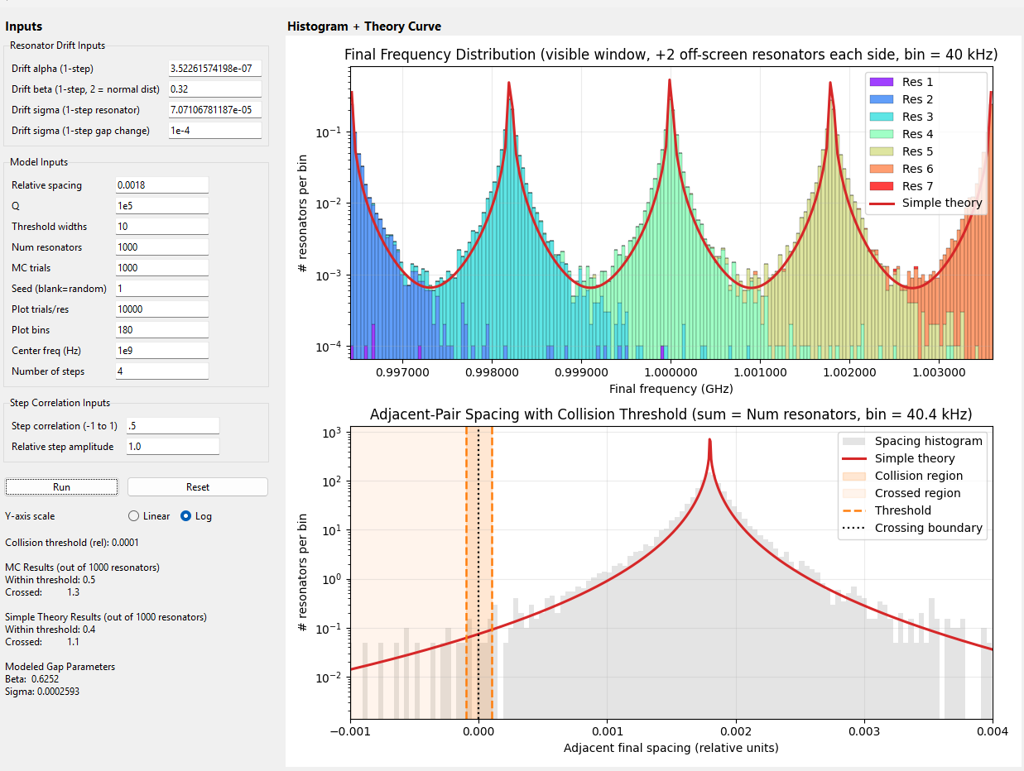
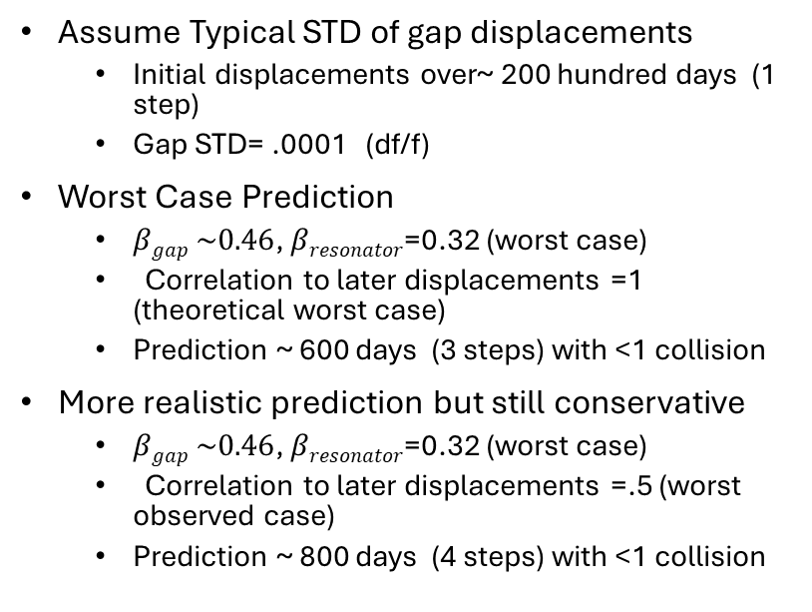
Simulate How Much heavier We Drift And Not Have Pile Up
Assume Typical STD of gap displacements
Initial displacements over~ 200 hundred days (1 step)
Gap STD= .0001 (df/f)
Worst Case Prediction
$βgap \sim 0.46$, $βresonator$=0.32 (worst case)
Correlation to later displacements =1 (theoretical worst case)
Prediction ~ 600 days (3 steps) with <1 collision
More realistic prediction but still conservative
$βgap \sim 0.46$, $βresonator$=0.32 (worst case)
Correlation to later displacements =.5 (worst observed case)
Prediction ~ 800 days (4 steps) with <1 collision

Slide 10
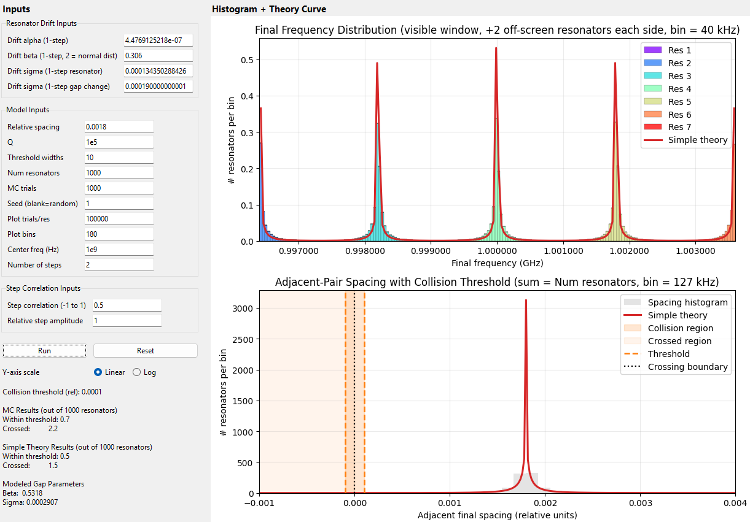
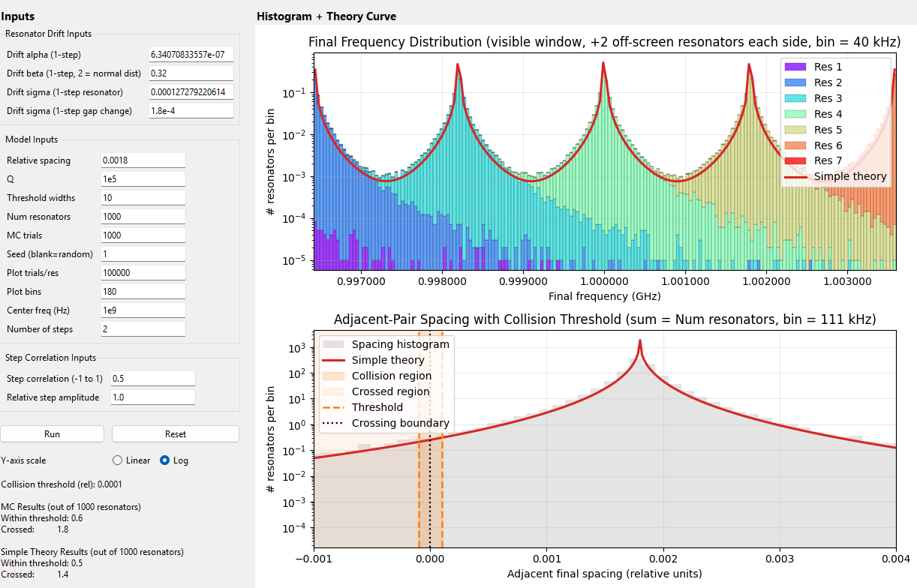
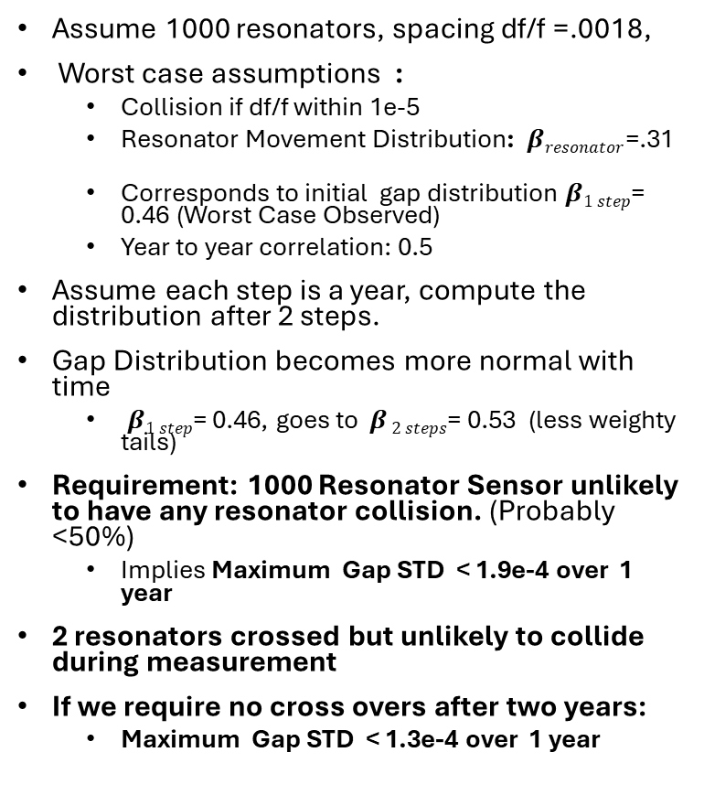
Requirement to Have No Collision in 1000 KID Sensor
Assume 1000 resonators, spacing df/f =.0018,
Worst case assumptions :
Collision if df/f within 1e-5
Resonator Movement Distribution: $βresonator$=.31
Corresponds to initial gap distribution $β1 step$= 0.46 (Worst Case Observed)
Year to year correlation: 0.5
Assume each step is a year, compute the distribution after 2 steps.
Gap Distribution becomes more normal with time
$β1 step$= 0.46, goes to $β 2 steps$= 0.53 (less weighty tails)
Requirement: 1000 Resonator Sensor unlikely to have any resonator collision. (Probably <50%)
Implies Maximum Gap STD < 1.9e-4 over 1 year
2 resonators crossed but unlikely to collide during measurement
If we require no cross overs after two years:
Maximum Gap STD < 1.3e-4 over 1 year

Slide 11
Compare to Distribution of Resonators in Sensors to Nominal .0018 spacing
In Empirical data, it looked like a few resonators did collide or cross
Be230518#1 -- .675 GHz to .6925 GHz , 44 resonators -> spacing of .00058, 3X the standard .0018 spacing
A typical bunches has a spacing .00032 , 5.4 X the nominal
This explains this explains why a few collisions are observed

Slide 12
Actions
Learn why L121120_1 is our most stable JPL device --Done.
It and the MIT devices have the fewest resonators. They are more compressed spatially so the tend to move together.
Does also explain why it had the most correlations over time? They tend to keep heading in the same direction.
Learn why Be230518#1 has much more neighbor displacement than others
Predict how observe red displacement scales to over to years using 50% correlation worst case. --Done.
Confirm that the 1.0018 spacing is correct
Get Fab date of all the sensors

Slide 13
Empirical data: Net Gap Displacement
Gap Drift Data is plotted in 2026-4-27 initial comparison of resonator drift in different devices.pptx
A summary table is shown to the right
For the model, we assume 1e-4 change occurring over 200 days to be representdative of this data
This is consistent with most of the devices measureded
Sensor | STD Net Change (df/f) | Number of Days
Be230518#1 | 1.0E-03 | 374
Be241202.1 | 9.0E-05 | 100
L121120_1 | 1.1E-04 | 384
MIT R3C4 Not Florinated | 1.0E-04 | 287
MIT R4C4 -Florintated | 1.0E-04 | 48

Slide 14
Empirical Measurements of Model Parameter β
(β measures the tails of the distribution)

Slide 15
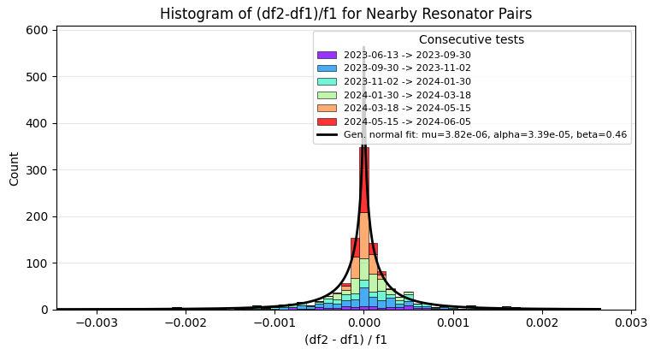
Gap Displacement of Be230518#1
Used only data from 233 lab, with - cheese plate, temp = 150 mK .
Selection: “Accepted scans”

Slide 16
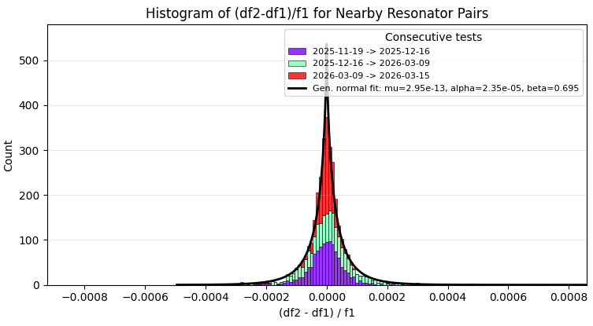
Gap displacement of Be241202.1
Selection: “125 mK hybridized”

Slide 17
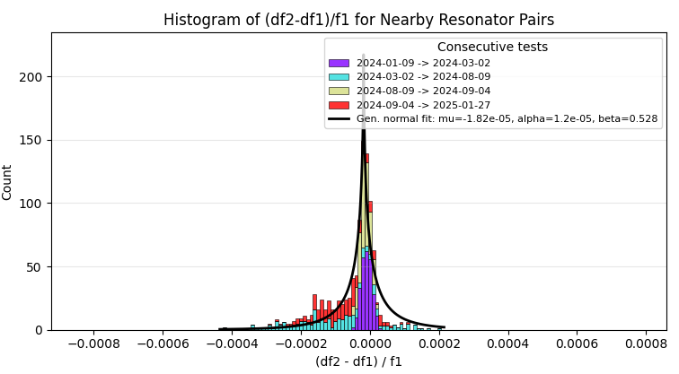
Gap displacement of 4- L231120_1 over similar VNA scans
Used all data from blackbody enclosure except the low power scan
Appears asymmetric
(Selection: “all bb except low power , T=150mK)

Slide 18
Gap displacement of JPL1-25-4LO-W4-R3C4
Not enough data

Slide 19
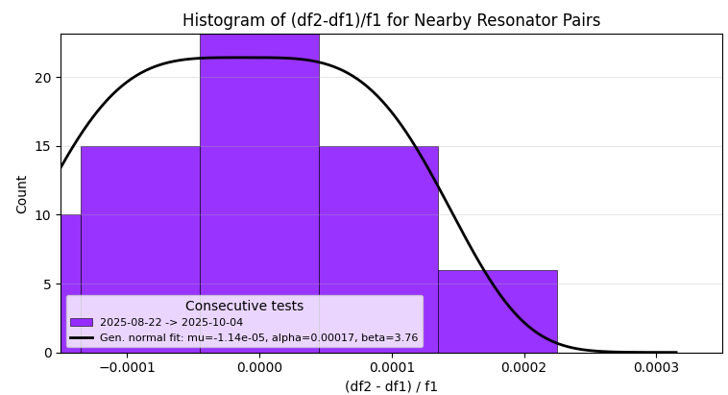
Gap displacement of JPLB1_25_4LO_W2 R4C4
Not enough data

